Slide 1


TEAMWORK (8)
Mohamed Hassan Anwer
Mohamed Osama Mohmed
Ahmed Magdy Mohamed
Bassam Emad elshabrawy

Slide 2
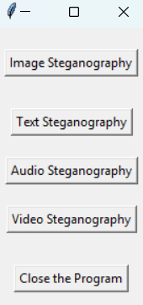
1
Image Steganography
2
Text Steganography
1
This hides secret messages within images.
This hides secret messages within text files.
2
3
Audio Steganography
This hide secret messages in audio files, like music or recordings
3
4
Video Steganography
5
Close The Program
4
This hides secret messages in video files. It could hide the message in individual frames of the video or make tiny changes to the video data .
This button closes the program..
5

Slide 3


Slide 4
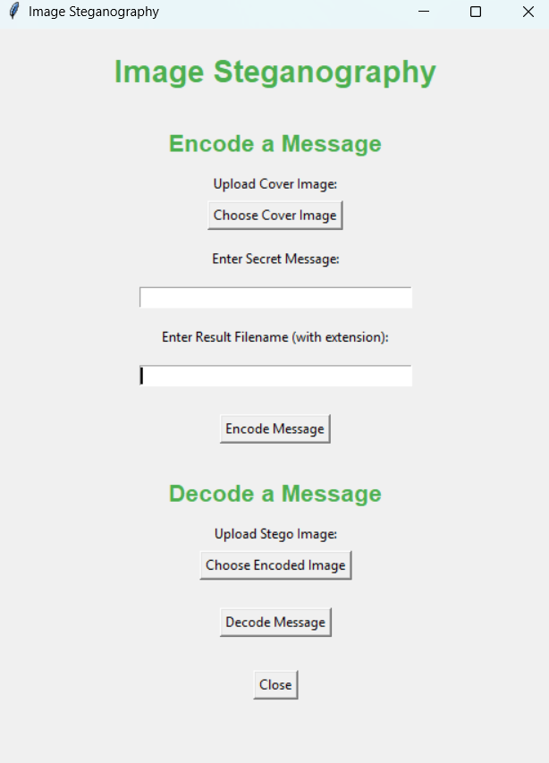
A
Encode A Message
This section is for hiding a secret message within an image.
A
1
1
Cover Image
2
Enter Secret Message
Enter Secret Message type in the text message you want to hide.
2
Select the image you'll use to hide your message
3
4
3
Enter Result File Name
4
Encode Message
B
1
the new image file that will be created with the hidden message.
This button starts the process of hiding your message within the image.
2
3

Slide 5
Key Concept
Modifying the least significant bits (LSBs) of the image pixels to embed data without altering its appearance.
A
1
2
3
4
B
1
2
C

Slide 6
Code Overview
A
The code includes three main functions:
msgtobinary: Converts data to binary format.
encode_img_data: Hides the data in an image.
decode_img_data: Extracts the hidden data from an image.
1
2
3
4
B
1
2
C

Slide 7
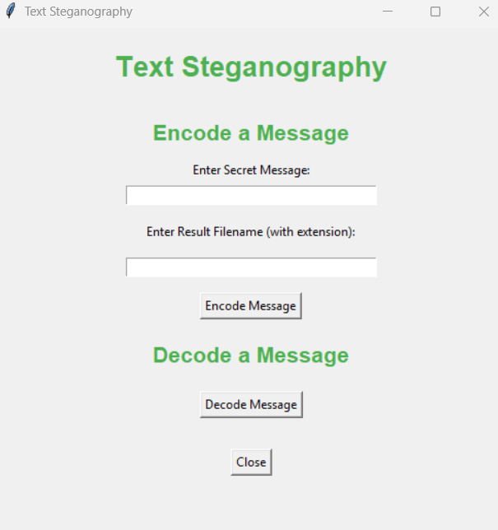
A
Encode A Message
This section is for hiding a secret message within an Text.
A
1
Enter Secret Message
2
Enter Result Filename
1
Enter Secret Message type in the text message you want to hide.
give a name to the new text file that will be created with the hidden message. Make sure to include the file extension (like .txt or .docx).
2
3
B
1
3
Encode Message
2
This button starts the process of hiding your message within the text.

Slide 8
B
Decode A Message
This section is for extracting a hidden message from an Text.
A
1
1
Decode Message
This button analyzes the text file and extracts the hidden message.
2
3
B
C
Close
1
This button back to main page …
c

Slide 9
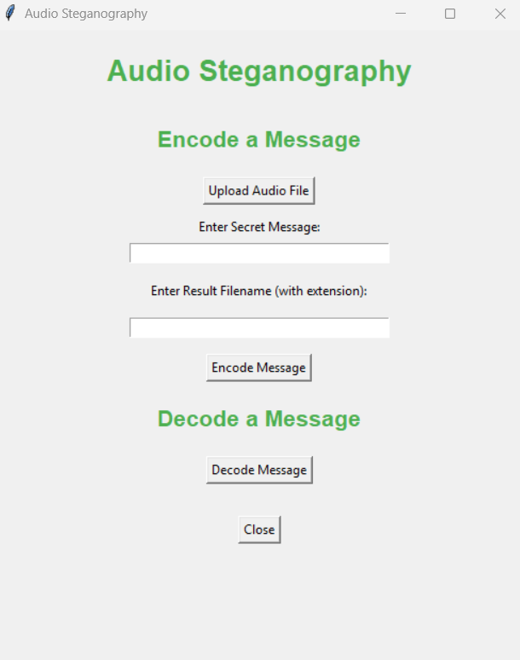
A
Encode A Message
This section is for hiding a secret message within an Audio.
A
1
Upload Audio File
2
Enter Secret Message
1
This is choose the audio file you want to use to hide your message.
Enter Secret Message type in the text message you want to hide.
2
3
Enter Result Filename
4
3
3
Encode Message
B
Enter Result Filename (with extension): Give a name to the new audio file that will be created with the hidden message inside. Make sure to include the file extension (like .mp3 or .wav).
This button starts the process of hiding your message within the Audio.
1
C

Slide 10
B
Decode A Message
This section is for extracting a hidden message from an Audio.
A
1
1
Decode Message
2
This button analyzes the text file and extracts the hidden message.
3
4
C
Close
B
1
This button back to main page …
C

Slide 11
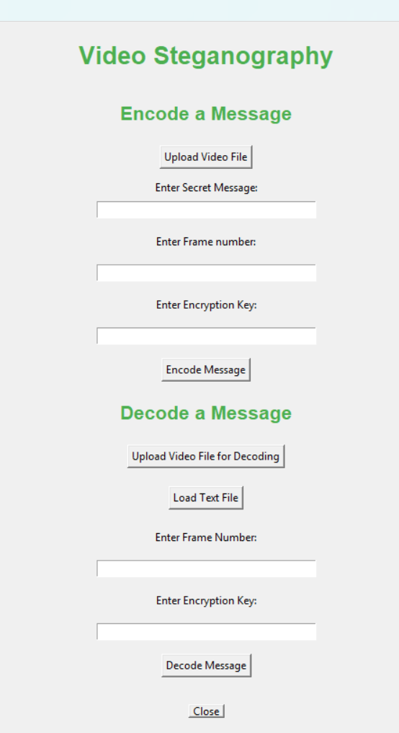
A
Encode A Message
This section is for hiding a secret message within an Video.
A
1
1
Upload Video File
2
Enter Secret Message
2
The user selects the video file they want to hide data in.
The user types in the message they want to conceal.
3
3
Enter Frame Number
4
5
The user specifies the frame number in the video where the message will be hidden.
B
Enter Encryption Key
Encode Message
1
4
5
2
The user enters a secret key to encrypt the message for added security.
The program hides the message within the video.
3
4
5
C

Slide 12
B
Decode A Message
This section is for extracting a hidden message from an Video.
A
1
1
Upload Video File For Decoding
2
Load Text File
2
The user can optionally load a text file that might contain information to aid in decoding..
The user enters the frame number where the hidden message is located.
3
4
3
Enter Frame Number
5
The user specifies the frame number in the video where the message will be hidden.
B
4
Enter Encryption Key
5
Decode Message
1
The program extracts the hidden message from the video.
The program extracts the hidden message from the video.
2
3
C
Close
This Button back to main page …
4
5
C

Slide 13


